Slide 1







9/20/2018
Normal Muscle Mass
Normal Muscle Mass
Increased Muscle Mass
Reduced Muscle Mass
Creatinine Input
Plasma Pool Content
Kidney Output
Normal Kidneys
Diseased Kidneys
Normal Kidneys
Diseased Kidneys

Slide 2
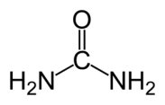
9/20/2018
Blood urea
Low urea
Pregnancy
Starvation
Chronic liver disease
High urea
Renal failure
High protein diet
Dehydration
Gastrointestinal bleed
Filtration markers
GFR
Creatinine
Inulin
Iothalamate
Measured
Estimated
Endogenous markers
Exogenous markers
MDRD
CKD-EPI

Slide 3






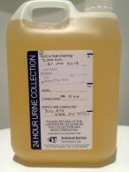
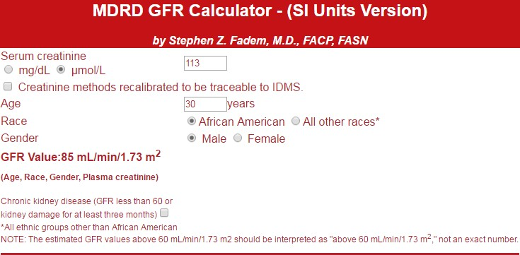
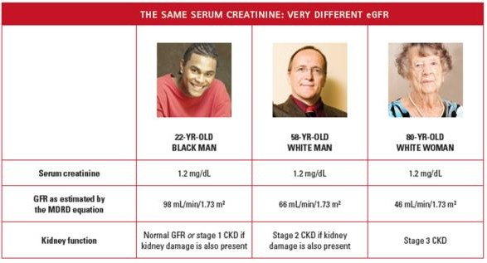
9/20/2018
Peforming a creatinine clearance
24 hr collection of urine
Creatinine measured on both serum and urine
Urine volume noted
Body surface area
Cr Cl: 165 mL/min BSA: 1.9 m²
Average body
_{Cr Cl: 83 mL/min}surface area 1.73 m²
BSA: 1.2 m²
Cr Cl
120 mL/min/1.73m²
120 mL/min/1.73m²
Problems of creatinine clearance
Overestimates GFR
Creatinine method problems
Inconvenience of 24 hour urine collection
Collection errors
eGFR
Results standardised for BSA
No 24 hour urine collections
No collection errors
Just one blood sample
MDRD eGFR calculator

Slide 4
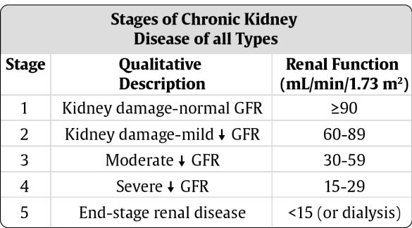
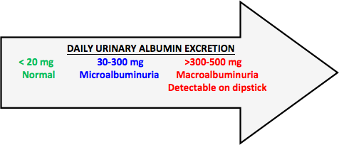
9/20/2018
eGFR for anybody? NO!
Extremes of age
Pregnant
Disease of skeletal muscle/amputation
Extremes of nutritional status (severe malnutrition or obesity, creatine supplements)
Have rapidly changing kidney function –ARF
CKD
CKD-EPI
Urine protein
Normal adults excrete less than 150 mg/d
Albumin <30 mg/d
Abnormal urinary protein excretion is a
marker of renal disease
Urine protein concentration : mg/dL
Protein to creatinine ratio : mg/mmoL
Albuminuria
Normalbuminuria :
“Microalbuminuria”:
Macroalbuminuria :
<30mg/d
30-300mg/d
>300mg/d
Spot urine albumin
Albumin to creatinine ratio
Best sample?

Slide 5
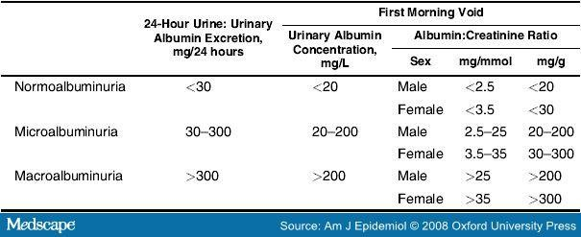
9/20/2018
Sample collection cont.
Recent exercise (within 24 hours before the test)
Recent sexual intercourse (within 24 hours before the test) in males
Illness
UTI
Menstruation or pregnancy in women
Osmolality
Osmolality is a count of the number of particles in a fluid sample.
Measured by osmometer
Plasma osmolality
The osmolality of plasma is closely regulated by anti-diuretic hormone (ADH).
275–295 mmol/kg
Usually depends on
serum sodium
blood glucose
blood urea
Calculated osmolality
Calculated osmolality=
2 x serum sodium + serum glucose + serum urea (all in mmol/L)
Thank You

